Slide 2
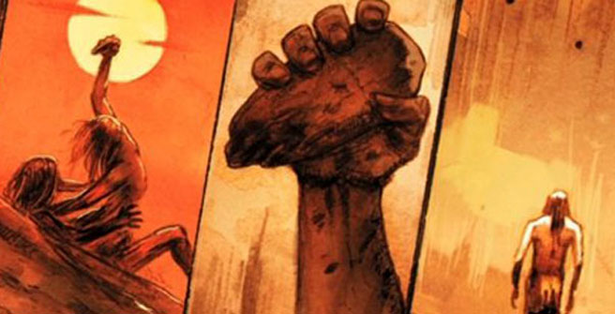

Slide 3
Genesis 4:2-5HCSB
² Then Now Abel became a shepherd of flocks, but Cain worked the ground. ³ In the course of time Cain presented some of the land’s produce as an offering to the Lord. ⁴ And Abel also presented an offering—some of the firstborn of his flock and their fat portions. The Lord had regard (look at, gaze at) for Abel and his offering, ⁵ but He did not have regard for Cain and his offering. Cain was furious (to be hot, burn, become angry), and he looked despondent (face fell).

Slide 4
Matthew 23:35HCSB
³⁵ so that upon you may come all the righteous blood shed on earth, from the blood of righteous Abel…
Hebrews 11:4HCSB
⁴ By faith (Trust) Abel offered to God a more acceptable sacrifice than Cain’s. Through this he received approval as righteous, God himself giving approval to his gifts; he died, but through his faith (Trust) he still speaks.

Slide 5
1 John 3:11-12HCSB
¹¹ For this is the message you have heard from the beginning, that we should love one another. ¹² We must not be like Cain who was from the evil one and murdered his brother. And why did he murder him? Because his own deeds were evil and his brother’s righteous.
Jude 1:8-10HCSB
⁸ Yet in the same way these dreamers also defile the flesh, reject authority, and slander the glorious ones. ⁹ But when the archangel Michael contended with the devil and disputed about the body of Moses, he did not dare to bring a condemnation of slander against him, but said, “The Lord rebuke you!” ¹⁰ But these people slander whatever they do not understand, and they are destroyed by those things that, like irrational animals, they know by instinct. ¹¹ Woe to
them! For they go the way of Cain,

Slide 6
Genesis 3:17-19HCSB
¹⁷ And He said to Adam, “Because you listened to your wife’s voice and ate from the tree about which I commanded you, ‘Do not eat from it’: The ground is cursed because of you. You will eat from it by means of painful labor all the days of your life. ¹⁸ It will produce thorns and thistles for you, and you will eat the plants of the field. ¹⁹ You will eat bread by the sweat of your brow until you return to the ground, since you were taken from it. For you are dust, and you will return to dust.”

Slide 7
Genesis 4:6-12HCSB
⁶ Then the Lord said to Cain, “Why are you furious? And why do you look despondent? ⁷ If you do what is right, won’t you be accepted? But if you do not do what is right, sin is crouching at the door. Its desire is for you, but you must rule over it.” ⁸ Cain said to his brother Abel, “Let’s go out to the field.” And while they were in the field, Cain attacked his brother Abel and killed him. ⁹ Then the Lord said to Cain, “Where is your brother Abel?” “I don’t know,” he replied. “Am I my brother’s guardian?” ¹⁰ Then He said, “What have you done? Your brother’s blood cries out to Me from the ground! ¹¹ So now you are cursed, alienated, from the ground that opened its mouth to receive your brother’s blood you have shed. ¹² If you work the ground, it will never again give you its yield. You will be a restless wanderer
on the earth.”

Slide 8
Hebrews 12:24KJV
²⁴ And to Jesus the mediator (a go-between, in order to make or restore peace and friendship) of the new covenant (a disposition; a Judge’s final sentencing or settlement of a criminal case), and to the blood of sprinkling, that speaketh (present, active, participle) better things (more useful, more serviceable, more advantageous, more excellent) than that of Abel.
Ephesians 1:7KJV
⁷ In whom we have redemption through his blood, the forgiveness of sins, according to the riches of his grace;

Slide 9
Leviticus 17:11-14ESV
¹¹ For the life of the flesh is in the blood, and I have given it for you on the altar to make atonement for your souls, for it is the blood that makes atonement by the life. ¹² Therefore I have said to the people of Israel, No person among you shall eat blood, neither shall any stranger who sojourns among you eat blood. ¹³ “Any one also of the people of Israel, or of the strangers who sojourn among them, who takes in hunting any beast or bird that may be eaten shall pour out its blood and cover it with earth. ¹⁴ For the life of every creature1 is its blood: its blood is its life. Therefore I have said to the people of Israel, You shall not eat the blood of any creature, for the life of every creature is its blood.

